Slide 1

RNN – Recurrent Neural Network using KERAS

Slide 2
Topics to be covered -
Basics of Deep Learning
BackPropogation Algorithm
RNN
LSTM
Keras
Uni Variate & Multi Variate Time Series
ARIMA Model

Slide 3
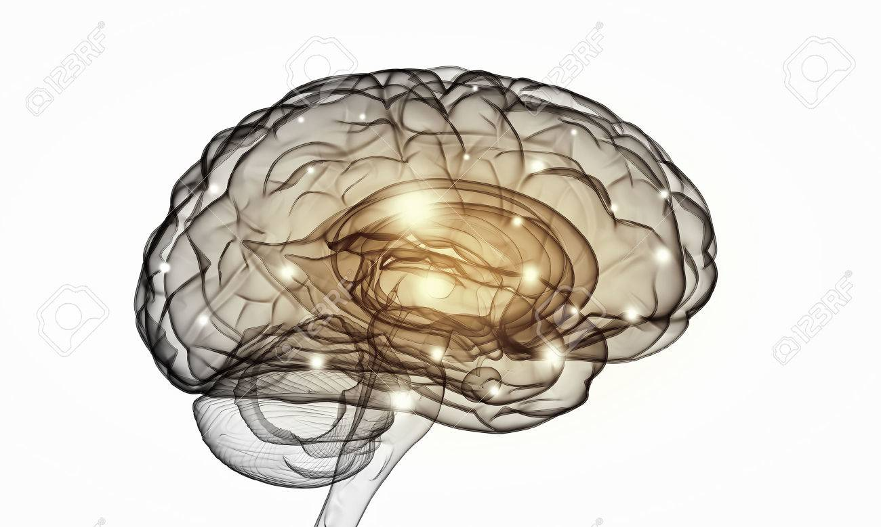





Deep Learning-
Machine trying to learn like a human brain
Neural Network learn relationship between cause and effect or organize large volumes of data into orderly and informative patterns like a human brain

Slide 4
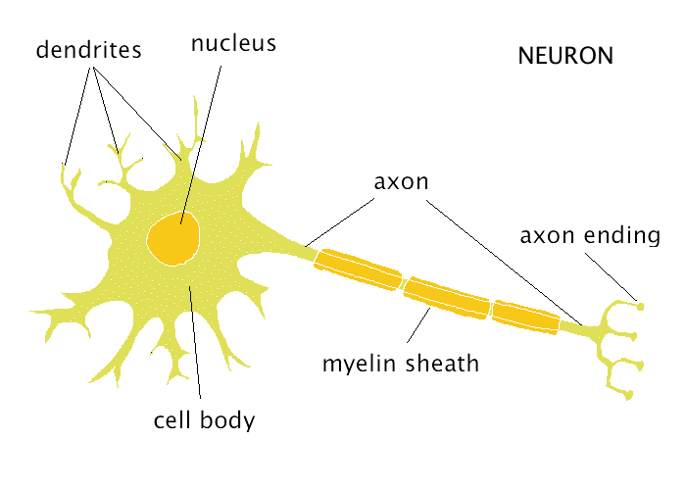
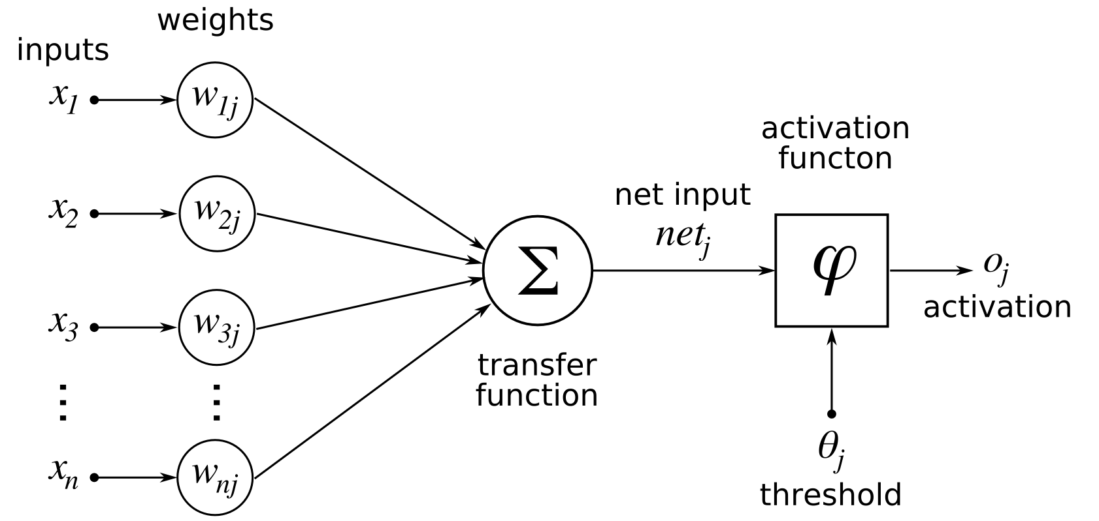
Artificial Neurons
From experience : examples / training data
Strength of connection between the neurons is stored as weight- value for the specific connection
Learning the solution to a problem = Changing the connection weights

Slide 5
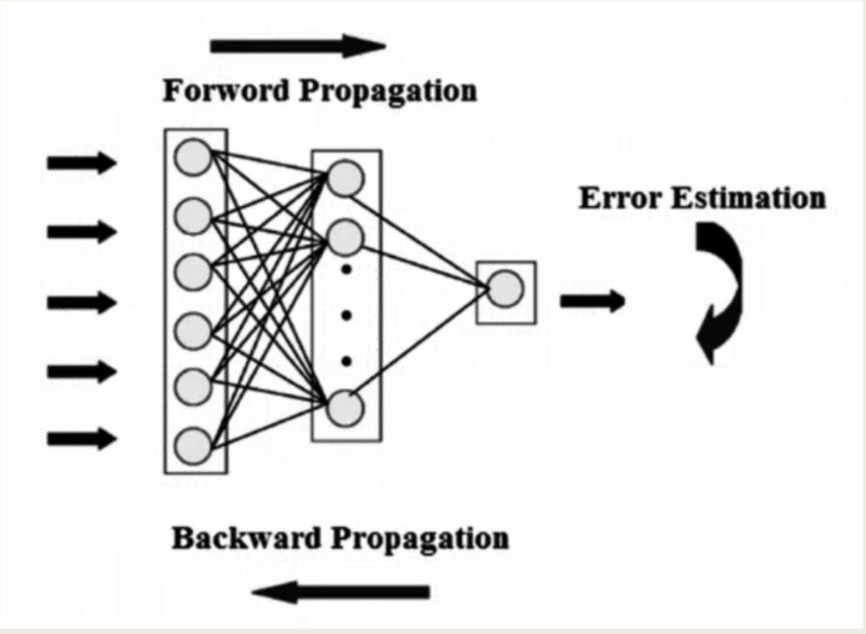
What is Backpropagation?
The Backpropagation algorithm looks for the minimum value of the error function in weight space using a technique called the delta rule or gradient descent. The weights that minimize the error function is then considered to be a solution to the learning problem.
Forward Propogation – In this step, the network is activated on one example and the error of (each neuron of) the output layer is computed
Backward Propogation – The network is used for
updating the weights. Starting at the output layer,
the error is propogated backwards through the
network layer by layer.
This is done by recursively computing the local
gradient of the neuron.

Slide 6
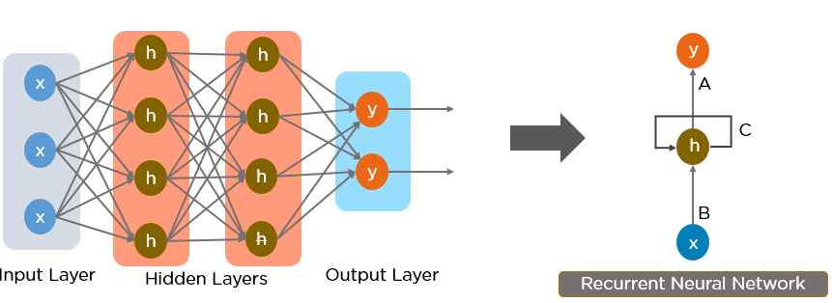
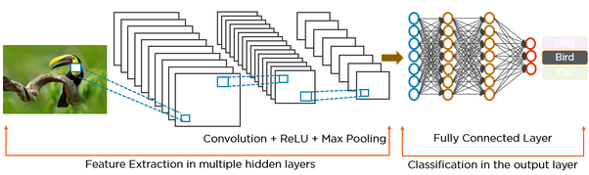
A Recurrent Neural Network looks something like this:
A Convolution Neural Network looks something like this:

Slide 7
Model of a Neuron
Input
Units
Connecting
Weights
Summing
function
Computation
(Dendrite)
(Synapse)
(Soma)
(Axon)

Slide 8
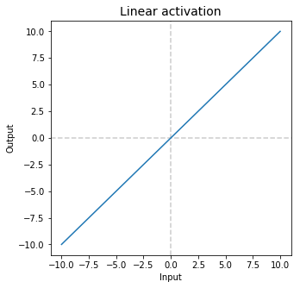
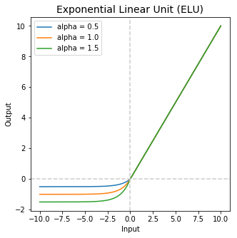
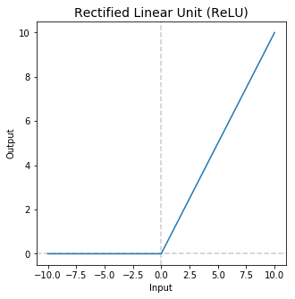
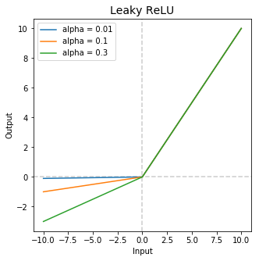
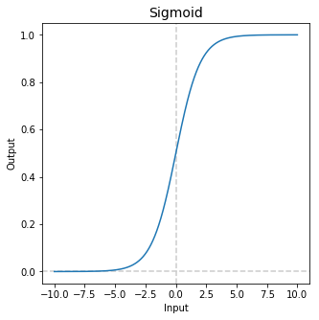
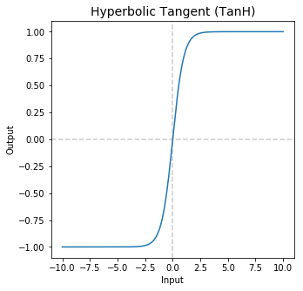
Activation function for firing Artificial Neurons

Slide 9

Optimizers -
Stochastic Gradient Descent (SGD)
-Single learning rate (termed alpha) for all weight updates
Adaptive Gradient Algorithm (AdaGrad)
-maintains a per-parameter learning rate that improves performance on problems with sparse gradients.
Root Mean Square Propagation (RMSProp)
-Maintains per-parameter learning rates that are adapted based on the average of recent magnitudes of the gradients for the weight (Eg. How quickly it is changing).
Adaptive Moment Estimation (ADAM)
-Best of AdaGrad and RMSProp

Slide 10
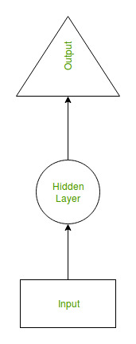
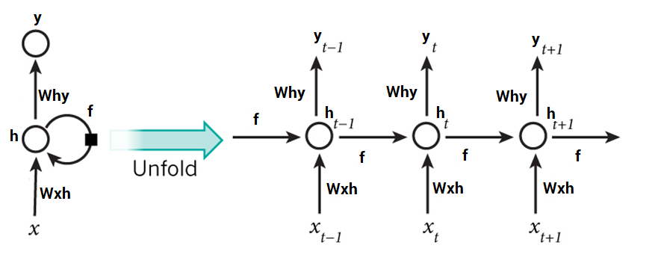
Recurrent Neural Network(RNN)
In traditional neural networks, all the inputs and outputs are independent of each other, but in cases like when it is required to predict the next word of a sentence, the previous words are required and hence there is a need to remember the previous words.
Thus RNN came into existence, which solved this issue with the help of a
Hidden Layer.
The main and most important feature of RNN is Hidden state, which
remembers some information about a sequence.

Slide 11
Advantages of Recurrent Neural Network
An RNN remembers each and every information through time. It is useful in time series prediction only because of the feature to remember previous inputs as well. This is called Long Short Term Memory.
Recurrent neural network are even used with convolutional layers to extend the effective pixel neighborhood.
Disadvantages of Recurrent Neural Network
Gradient vanishing and exploding problems.
Training an RNN is a very difficult task.
It cannot process very long sequences if using tanh or relu as an activation function.

Slide 12
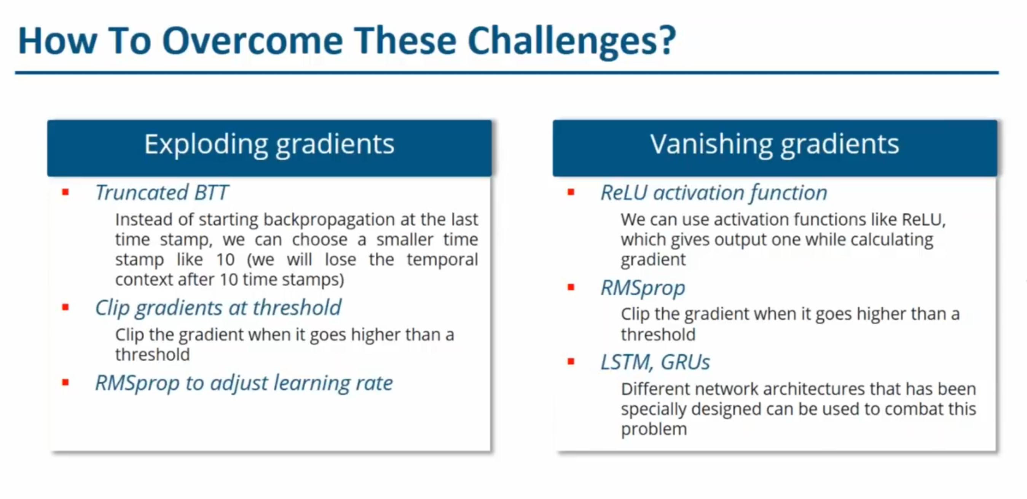

Slide 13
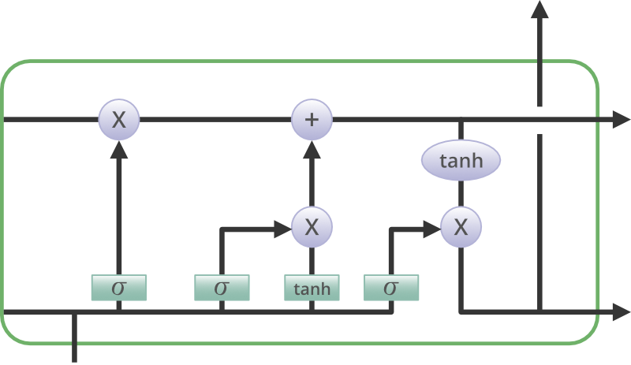
LSTM - Long Short Term Memory
An LSTM is a special kind of RNN architecture, capable of learning long-term dependencies.
LSTM uses gates to control the memorizing process
Tanh: Derivative can sustain for a long range
Sigmoid: As Sigmoid can output 0 or 1, it can be used to forget or remember the information.
LSTM networks generally outperform RNNs
Can be used for Text Analytics, Time Series Forecasting etc.

Slide 14
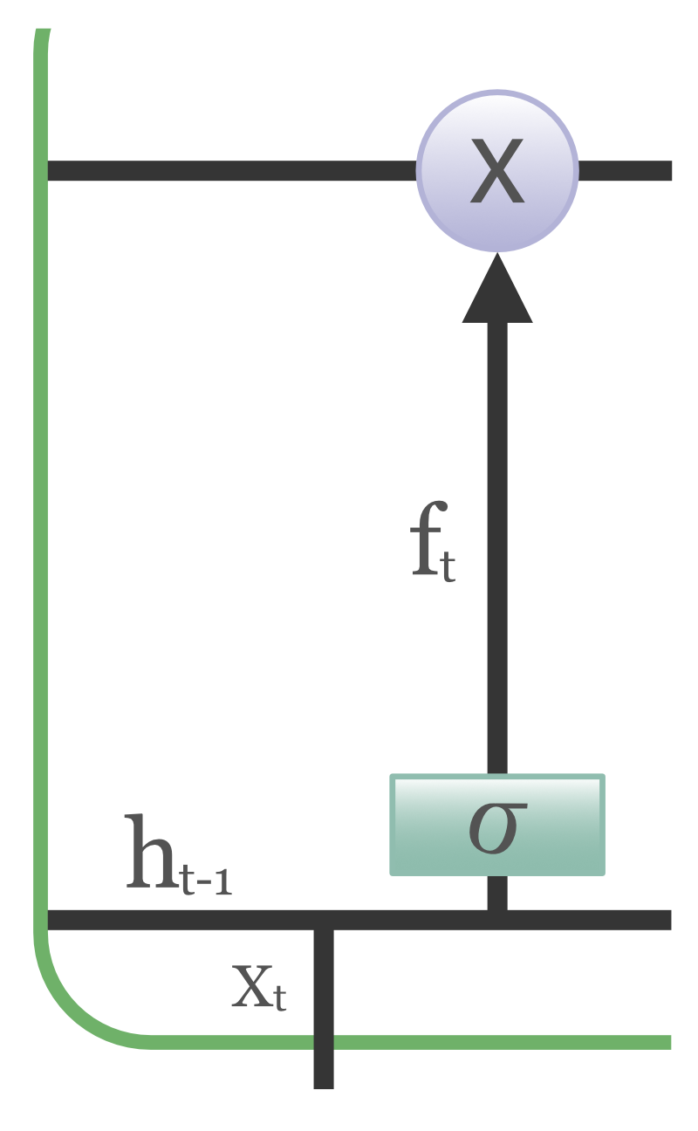
Forget Gate:
Gate 1: What to Forget?
This sigmoid layer is called the “forget gate layer.”
It looks at h(t−1) and x(t), and outputs a number
between 0 and 1
The closer to 0 means to forget, and the closer to
1 means to keep.
If the context has changed from one to another,
previous context will be forgotten

Slide 15
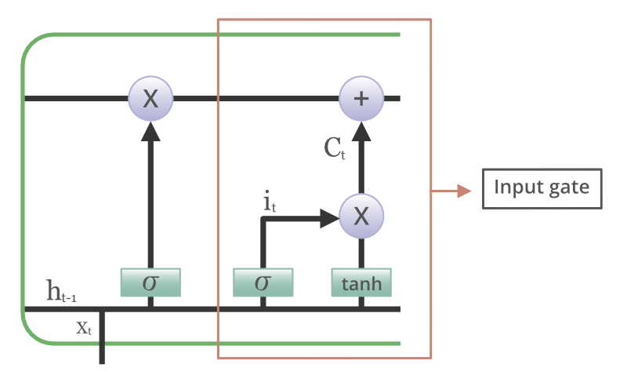
Input gate:
Gate 2: What new information to store?
tanh function to squish values between -1 and 1 to help regulate the network
This sigmoid layer called the “input gate layer” decides which values we’ll update. Values will be between 0 and 1. 0 means not important, and 1 means important
Sigmoid output will decide which
information is important to keep from
the tanh output

Slide 16
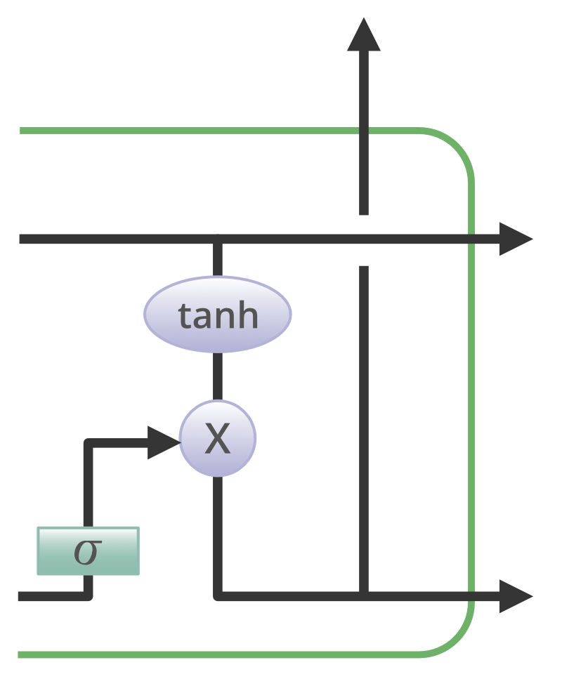
Output gate:
Gate 3: Output Gate
Decides what the next hidden state should be
previous hidden state and the current input is passed into a sigmoid function
sigmoid layer decides what parts of the cell state we’re going to output
cell state is put through tanh (to push the values to
be between −1 and 1) and multiply it by the output
of the sigmoid gate

Slide 17
Time Series data :
A time series is a sequence of data being recorded at specific time intervals
It is used to predict the future values based on the previous observed values.
In supervised learning algorithm we usually see how a variable is dependent on the other but in time series we have only one variable that is time X axis we have the time and in y axis we have the magnitude of the data
Eg : you want to predict the sales of your customer based on time. If you are having a coffee shop you want to predict what could be your next month sales based on your past input.
Time will be mostly divided into equal intervals like a day, week, month, year, decade, century etc.

Slide 18
Use of time Series:
Business Forecasting – Predict the stock market tomorrow, sales next day
Understand past behaviour – like seasonality. During summer more demand for ac, more birth of a bird is seasonality
Plan future – Analyse the past and can predict the future
Evaluate current accomplishment – for example you had a plan to sell 100 chocolates a day. But did you really sell that

Slide 19
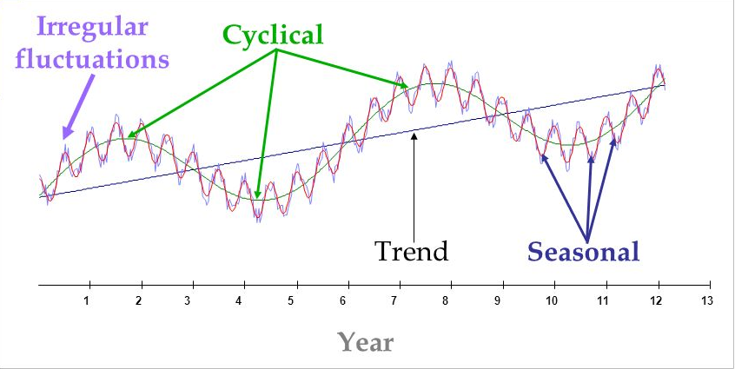
Components of time series :
Trend –
Trend is the increase or decrease in the series over a period of time, it persists over a long period of time
Ex. Population growth over the years can be seen as an upward trend
Seasonality –
Regular pattern of up and down fluctuations. Short – term variation occurring due to seasonal factors. Ex. Ice cream sales goes high in summer
Irregularity
It is also called residual. Ex. If there is a flood at
your place and there is more sales of medicines
and ointments.
Which was not predicted and occurs very randomly.
Cyclicity
It is a medium – term variation caused by
circumstances, which repeat in irregular intervals.
They can happen in 2 years, 2 days or in a decade or so.
Eg. Recession

Slide 20
What is stationarity ?
TS has a particular behaviour over time, there is a very high probability that it will follow the same in the future.
It should have a constant mean
It should have a constant variance.
Auto covariance that does not depend on time
Mean or variance should be equal with different time intervals. Variance is usually the distance from the mean
Auto covariance is If u are standing at t and your previous time period is t-1 and t-2. It should not have any correlation between them.
Tests to check Stationarity :
Rolling Statistics
Mostly visual technique not good for prd purpose mainly used for poc.
ADCF Test (Augmented Dickey Fuller Test)
We get a test statistics and critical values where in if we get test statistics lesser than the critical value we can reject the null hypothesis and we say it to be stationary.

Slide 21
ARIMA Model :
The ARIMA Algorithm is a class of models that captures temporal structures in time series data. However using only ARIMA model, it is hard to model the nonlinear relationships between variable.
AR - Auto Regressive
MA - Moving Average
I - Integration
AR term refers to the past values used for forecasting the next value.
The AR term is defined by the parameter ‘p’ in arima. The value of ‘p’ is determined using the PACF plot.
MA term is used to defines number of past forecast errors used to predict the future values.
The parameter ‘q’ in arima represents the MA term. ACF plot is used to identify the correct ‘q’ value.
Order of differencing(I) specifies the number of times the differencing operation is performed on series to make it stationary.
Test like ADF and KPSS can be used to determine whether the series is stationary and help in identifying the d value.

Slide 22
Software Libraries :
Caffe: from Berkeley and now Facebook. Mostly for computer vision. See also Caffe2
Theano: from University of Montréal. Discontinued in September 2017.
Torch/PyTorch: from Facebook
TensorFlow: from Google
Keras: from Google, built on top on TensorFlow or Theano, making it easy to build deep architectures.

Slide 24
Keras Modeling Process
Define
DNN
CNN
RNN
Compile
Optimizer
Loss
Metrics
Fit
Batch Size
Epochs
Data Splits
Predict
Number
Classes
Probability

